Slide 1
Swing GUIs
Top-level component: usually JFrame or JDialog.
Secondary components (containers),used to group and layout
simpler components: often JPanel.
Atomic components, which correspond to the various GUI
elements: JButton, JTextField, JTable, JScrollBar, . ..

Slide 2
How to build a Swing frame
Create a class that inherits from a top-level component (JFrame)
Set up a content pane within the top-level component class
either get the default content pane from the top-level component
or create your own JPanel and set it to the top-levelcomponent
Normally, set a layout manager of the content pane
Add components to the content pane
Set the top-level frame to visible, and possibly specify other options

Slide 3
A few useful Swing components
JLabel: simple text label or picture
JButton: clickable button
JComboBox: pull-down menu with mutually-exclusive options
JList: list of selectable options
JTextField: single-line text
JTextArea: multi-line text
JScrollPane: scroll bar
JToolBar: list of clickable buttons
JOptionPane: pop-up dialog boxes

Slide 4
Simple Swing programme
import javax.swing.*;
public class Simple2 extends JFrame{//inheriting JFrame
JFrame f;
Simple2(){
JButton b=new JButton("click");//create button
b.setBounds(130,100,100, 40); //x axis, y axis, width, height
add(b);//adding button on frame
setSize(400,500); //400 width and 500 height
setLayout(null); //using no layout managers
setVisible(true); //making the frame visible
}

Slide 5
Simple Swing programme
public static void main(String[] args) {
new Simple2();
}
}

Slide 6
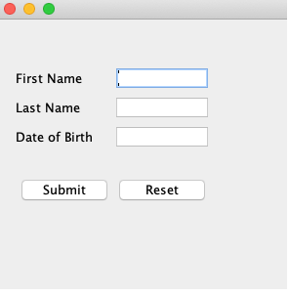
Example-01

Slide 7
Java Swing Example
import javax.swing.*;
public class SwingApp {
SwingApp(){
JFrame f = new JFrame();
JLabel firstName = new JLabel("First Name");
firstName.setBounds(20, 50, 80, 20);
JLabel lastName = new JLabel("Last Name");
lastName.setBounds(20, 80, 80, 20);

Slide 8
Java Swing Example
JLabel dob = new JLabel("Date of Birth");
dob.setBounds(20, 110, 80, 20);
JTextField firstNameTF = new JTextField();
firstNameTF.setBounds(120, 50, 100, 20);
JTextField lastNameTF = new JTextField();
lastNameTF.setBounds(120, 80, 100, 20);
JTextField dobTF = new JTextField();
dobTF.setBounds(120, 110, 100, 20);

Slide 9
Java Swing Example
JButton sbmt = new JButton("Submit");
sbmt.setBounds(20, 160, 100, 30);
JButton reset = new JButton("Reset");
reset.setBounds(120,160,100,30);
// Add to the panel
f.add(firstName);
f.add(lastName);
f.add(dob);
f.add(firstNameTF);

Slide 10
Java Swing Example
f.add(lastNameTF);
f.add(dobTF);
f.add(sbmt);
f.add(reset);
f.setSize(300,300);
f.setLayout(null);
f.setVisible(true);
}

Slide 11
Java Swing Example
public static void main(String[] args) {
// TODO Auto-generated method stub
SwingApp s = new SwingApp();
}
}

Slide 12
Java AWT
import java.awt.*;
public class AwtApp extends Frame {
AwtApp(){
Label firstName = new Label("First Name");
firstName.setBounds(20, 50, 80, 20);
Label lastName = new Label("Last Name");
lastName.setBounds(20, 80, 80, 20);
TextField firstNameTF = new TextField();
firstNameTF.setBounds(120, 50, 100, 20);

Slide 13
Java AWT
TextField lastNameTF = new TextField();
lastNameTF.setBounds(120, 80, 100, 20);
TextField dobTF = new TextField();
dobTF.setBounds(120, 110, 100, 20);
Button sbmt = new Button("Submit");
sbmt.setBounds(20, 160, 100, 30);
Button reset = new Button("Reset");
reset.setBounds(120,160,100,30);

Slide 14
Java AWT
add(firstName);
add(lastName);
add(dob);
add(firstNameTF);
add(lastNameTF);
add(dobTF);
add(sbmt);
add(reset);

Slide 15
Java AWT
setSize(300,300);
setLayout(null);
setVisible(true);
}
public static void main(String[] args) {
AwtApp awt = new AwtApp();
}

Slide 16
Action Events
AWT events :-It is the root event class for all SWING events. This class and its subclasses supercede the original java.awt.Event class.
Action Event:-The ActionEvent is generated when the button is clicked or the item of a list is double-clicked
InputEvent:-The InputEvent class is the root event class for all component-level input events.
Key Event:-On entering the character the Key event is generated.
Mouse Event:-This event indicates a mouse action occurred in a component.
WindowEvent:-The object of this class represents the change in the state of a window.

Slide 17
Action Events
AdjustmentEvent:-The object of this class represents the adjustment event emitted by Adjustable objects.
ComponentEvent:-The object of this class represents the change in the state of a window
Container Event:-The object of this class represents the change in the state of a window.
MouseMotionEvent:-The object of this class represents the change in the state of a window.
PaintEvent:-The object of this class represents the change in the state of a window.

Slide 18
Example For ActionEvent
//import the Libraries
import java.awt.BorderLayout;
import java.awt.event.ActionEvent;
import java.awt.event.ActionListener;
import javax.swing.JButton;
import javax.swing.JFrame;
import javax.swing.JTextArea;
// create the class
public class ActionListenerTest extends JFrame implements ActionListener{

Slide 19
Example For ActionEvent
JButton button;
JFrame frame;
JTextArea textArea;
public ActionListenerTest() {
button = new JButton("Click Me");
frame = new JFrame("ActionListener Test");
textArea = new JTextArea(5, 40);
button.addActionListener(this);
textArea.setLineWrap(true);
frame.setLayout(new BorderLayout());
frame.add(textArea, BorderLayout.NORTH);
frame.add(button, BorderLayout.SOUTH);
frame.pack();
frame.setDefaultCloseOperation(JFrame.EXIT_ON_CLOSE);
frame.setVisible(true);
}

Slide 20
Example For ActionEvent
public void actionPerformed(ActionEvent e) {
textArea.setText(textArea.getText().concat("You have clickedthe button\n"));
}
public static void main(String args[]) {
ActionListenerTest test = new ActionListenerTest();
}
}

Slide 21
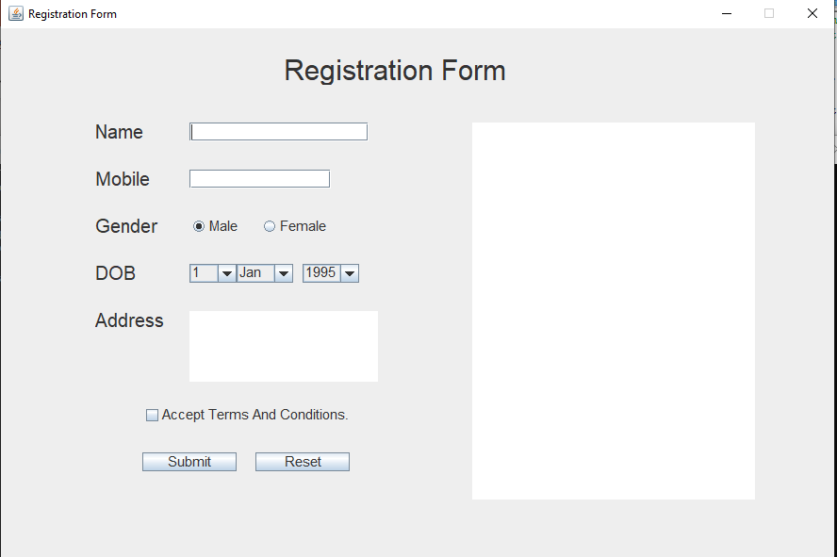
Trying this Question
Create the Registration form same as below picture

